Slide 1
CSE322
Concept of Computability
Lecture #40

Slide 2
Computability
The Problem of finding out whether a given problem is “Solvable” by automata reduces to the evaluation of function on the set of natural numbers or a given alphabet by mechanical means.

Slide 3
Primitive Recursion Function
Consider the function exp(x, y) = x^{y}
x⁰ = 1
x¹ = x
x² = x . x
… x^{y} = x. x. x……( y occurrences of x)
x^{y+1} = x . x ^{y}

Slide 4
The two Rewriting Rules:-
    X⁰ = 1
    X^{y+1} = x. x^{y}
    Reducing exponential to reduce multiplication
    x.0 = 0
    X(y+1)= x + x . y
    Primitive Recursion is spirit of
    Converting exponential into multiplication or addition.
    Or in general we can say complex functions into easy functions.

Slide 5
The primitive recursive functions are among the number-theoretic functions, which are functions from the natural numbers (nonnegative integers) {0, 1, 2, ...} to the natural numbers. These functions take n arguments for some natural number n and are called n-ary.
The basic primitive recursive functions are given by these axioms:
Constant function or Zero function: The 0-ary constant function 0 is primitive recursive.
Successor function: The 1-ary successor function S, which returns the successor of its argument is primitive recursive. That is, S(k) = k + 1.
Projection function: For every n≥1 and each i with 1≤i≤n, the n-ary projection function P_{i}^{n}, which returns its i-th argument, is primitive recursive.

Slide 6

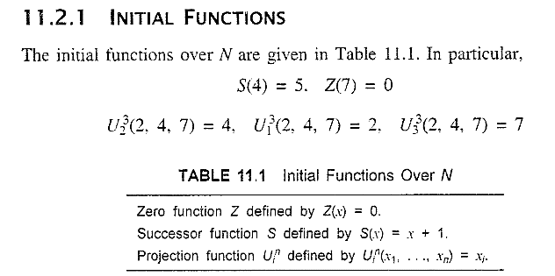


Slide 7
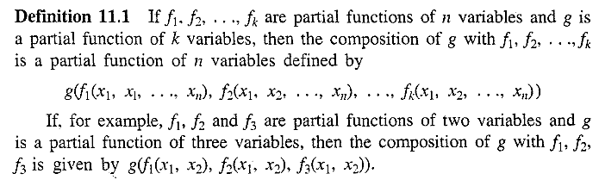

Slide 8
Complexity
Time Complexity:- Amount of time taken by a Machine to run input string.
Space Complexity:- Amount of space or memory required by machine to implement input string.

Slide 9
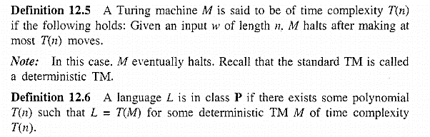

The classes of P and NP problem

Slide 10
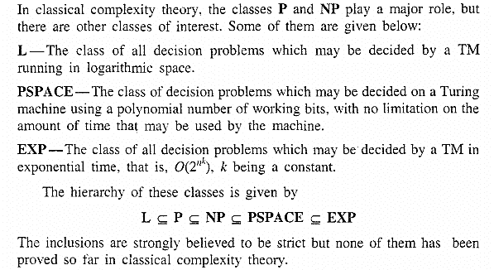
Power of Quantum Computation

